Slide 1
PROJECT NAME
MINI MART
Online Grocery Shopping System

Slide 2
GROUP MEMBERS NAME
RATRI DAS
(Roll No: 201771020013)
SHRESHTHA SIL
(Roll No: 201771020016)
SHREYA MOHANTA
(Roll No: 201771020017)
TANIA PARVIN
(Roll No: 201771020023)

Slide 3
COLLAGE DETAILS
AMEX COLLEGE
We are the B.C.A(H) Students of 6TH Semester

Slide 4
OUR PROJECT CONCEPT
“MiniMart” is an online grocery shopping system. This project has been developed on PHP and MySQL. The main aim of this project is to develop a system which provides all the information relates to online grocery products.

Slide 5
SOFTWARE AND HARDWARE
REQUIREMENT
Software:-
Browser - Microsoft Edge / Google Chrome /
Mozilla Firefox
Operating System - Windows (7 / 10 / 11)
Hardware: -
RAM - 4 GB RAM and above
Processor – Core 2 Duo processor and above

Slide 6
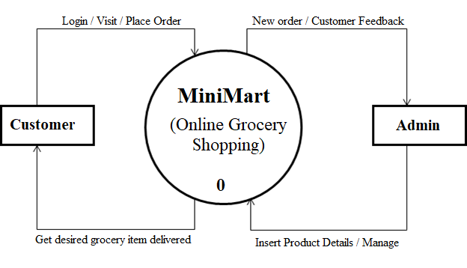
DFD LEVEL - 0

Slide 7
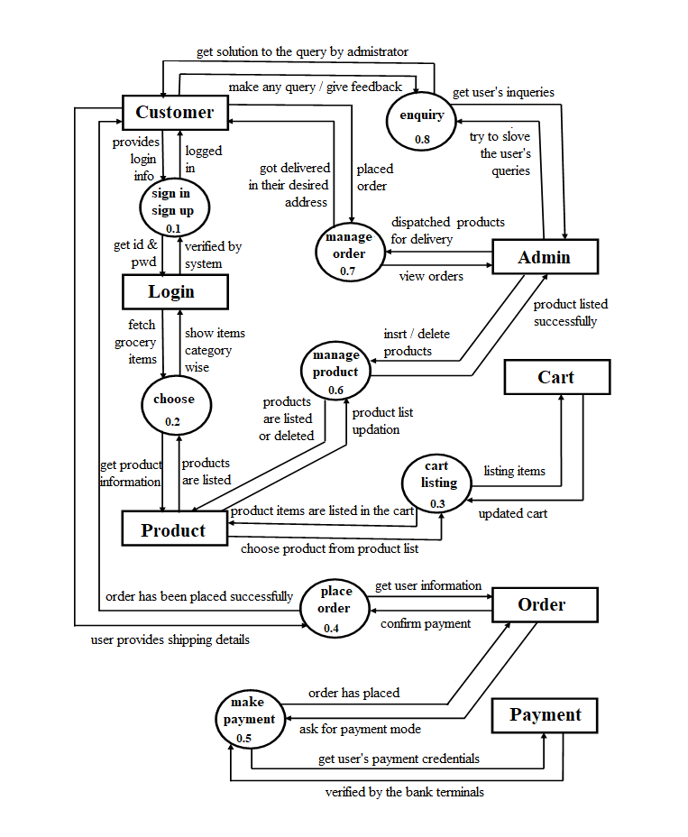
DFD LEVEL - 1

Slide 8
ERD

Slide 9
ADVANTAGE OF OUR PROJECT
Extremely convenient – Online grocery shopping has come as a relief for everyone as it saves times and is incredibly easy to use. All one needs is an internet connection or the interface on their device.
Limited luxury spending – It’s easy to get sucked into the vortex of products people don’t need at a traditional grocery store and they end up spending more than they actually intended to. But during online shopping they can have a specific list and limit useless purchase. Which is helpful if they’re on a strict budget and always end of buying things they have no actual use for.
Various offers and coupons – One strong plus point to online grocery shopping is the infinite offers, discounts and coupons customer can get.
Fresh and quality product assurance – People will get the fresh products delivered to their doorstep just with a few clicks. In case someone receive groceries, which are perishable or in poor quality, he / she can get a refund or replacement or return the product.
24/7 ordering and customer services – Previously to purchase groceries, people cannot make shopping after a particular time from the grocery stores. But now as grocery delivery services emerged everyone can shop at any time and get their groceries delivered to their door. Even users can resolve any of the queries by making a call to the customer service executives who will be available all the time to answer all the questions related to the products or services.

Slide 11
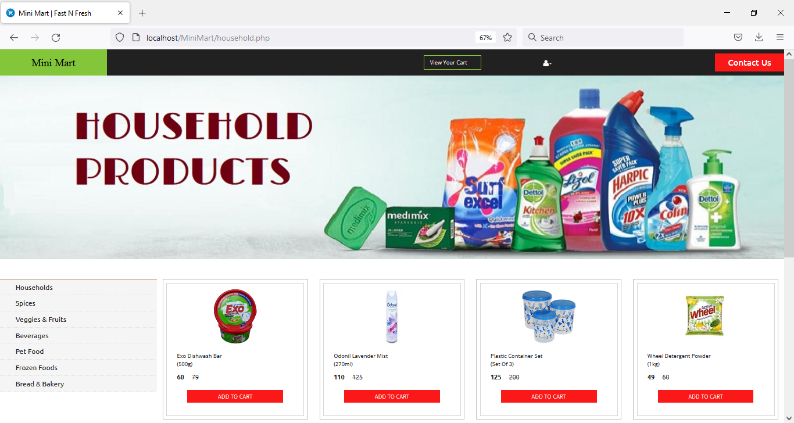
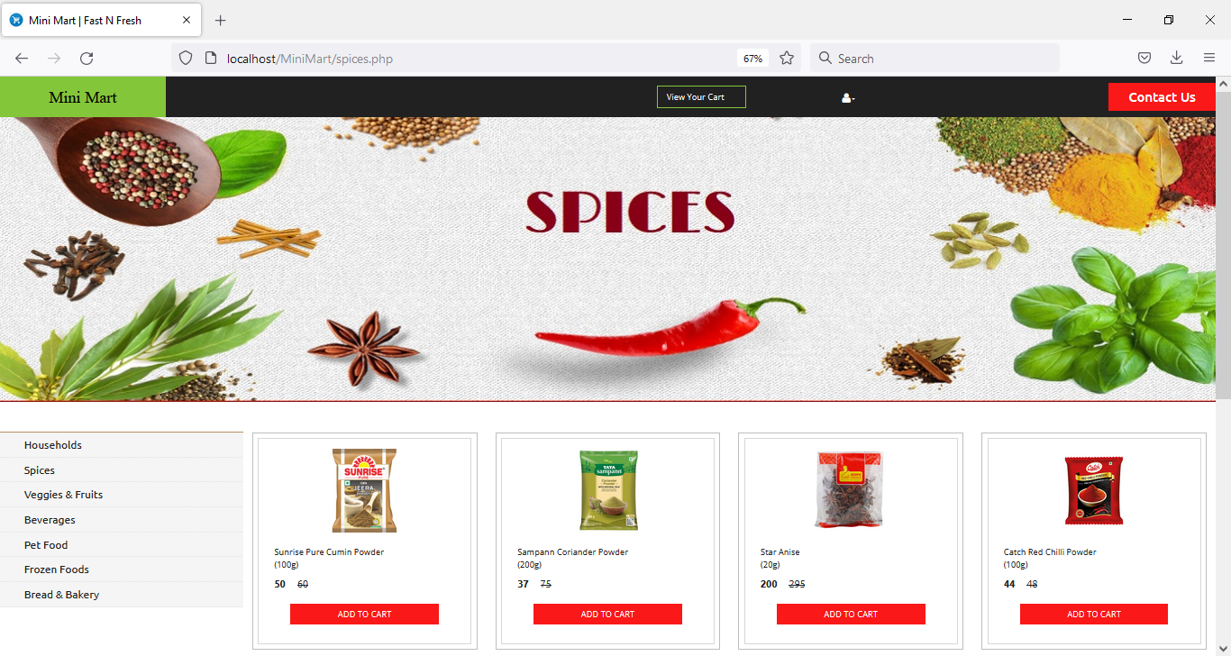
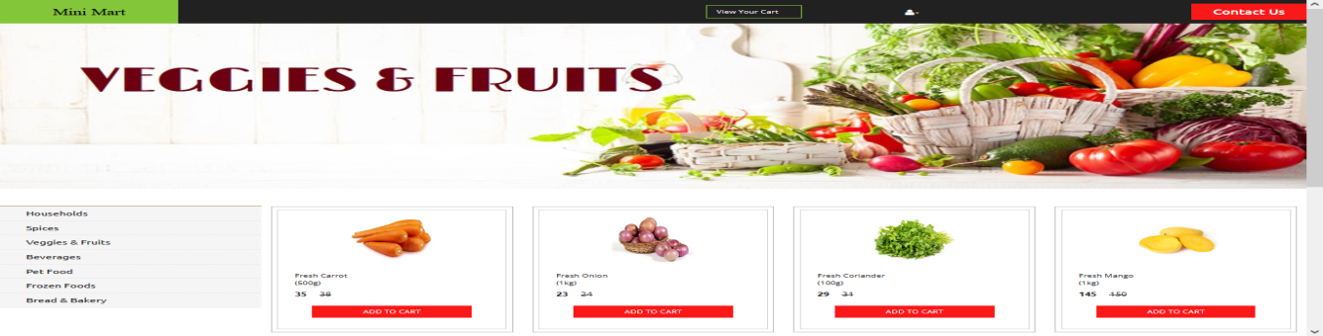

Slide 12
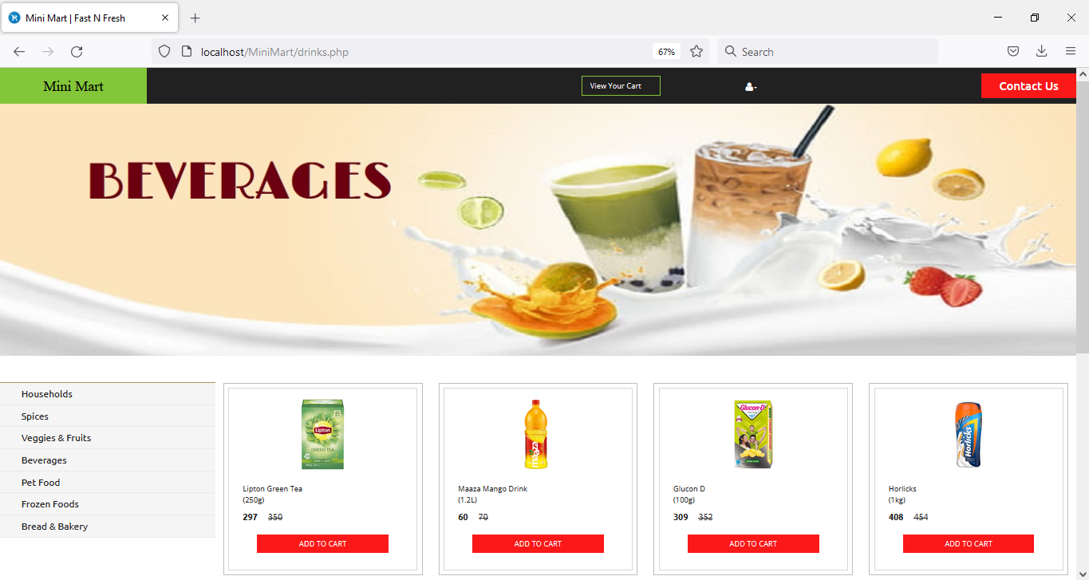
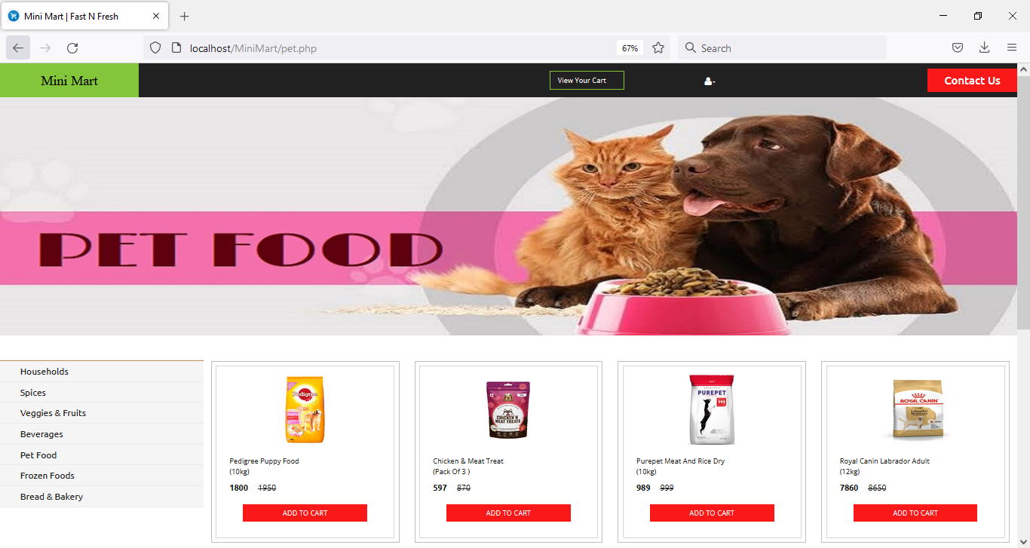
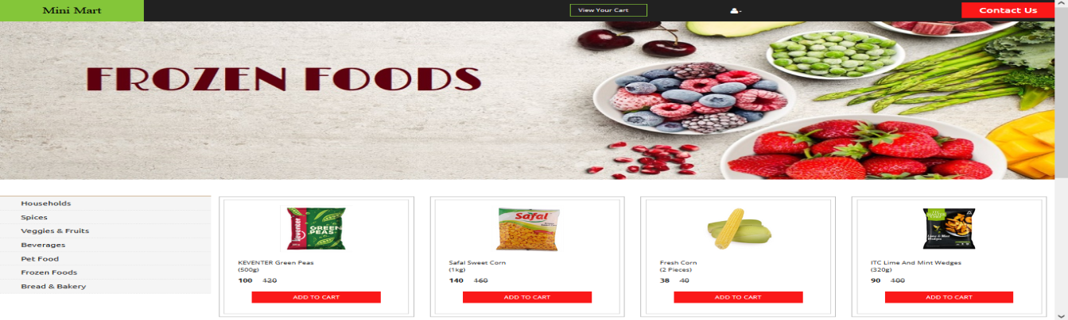

Slide 13
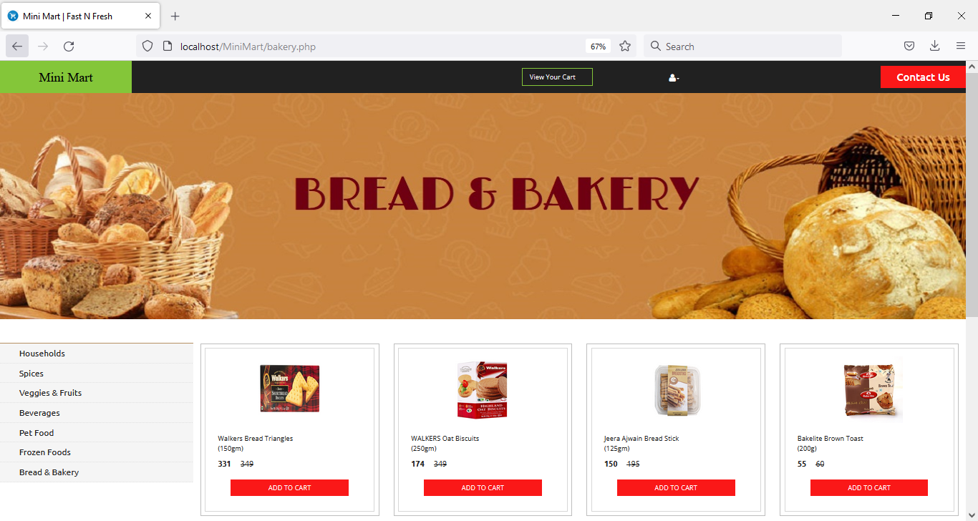
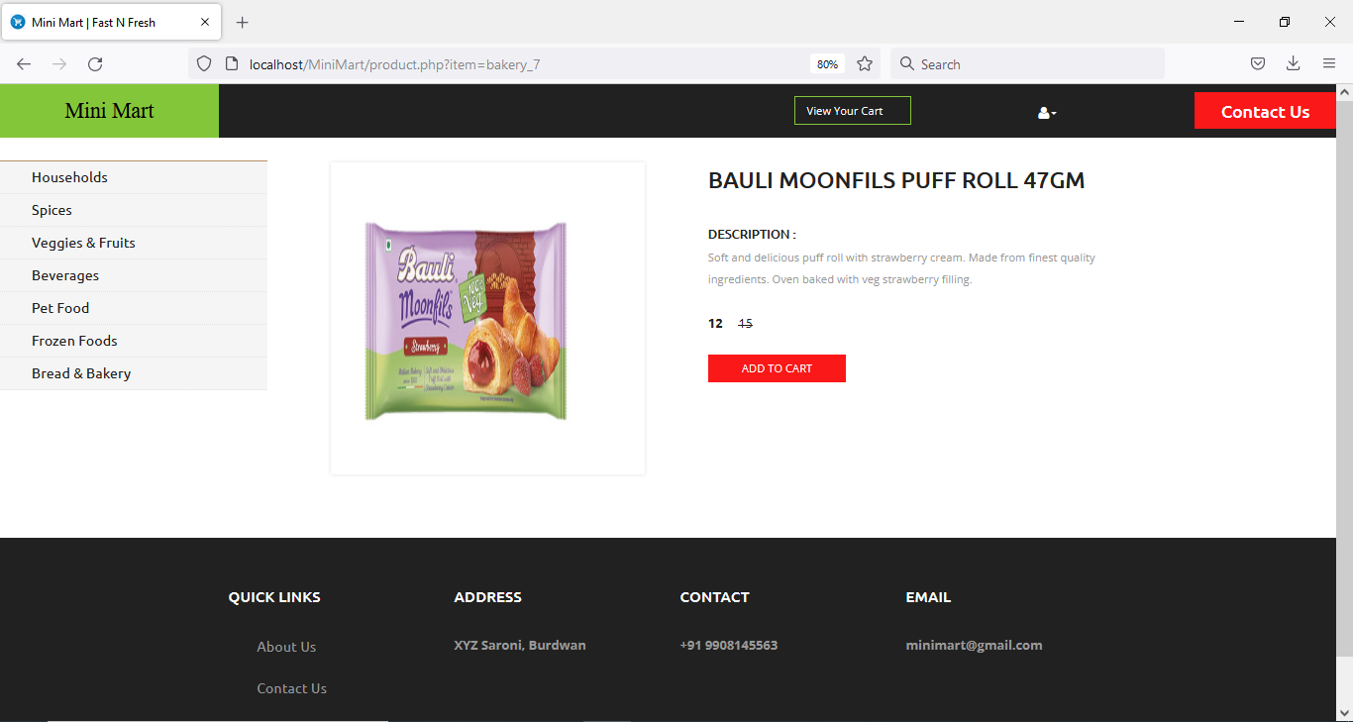
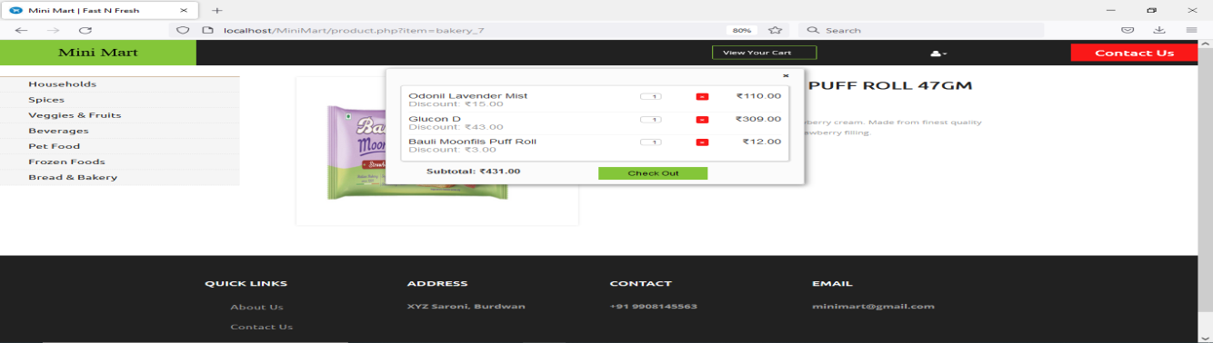

Slide 14
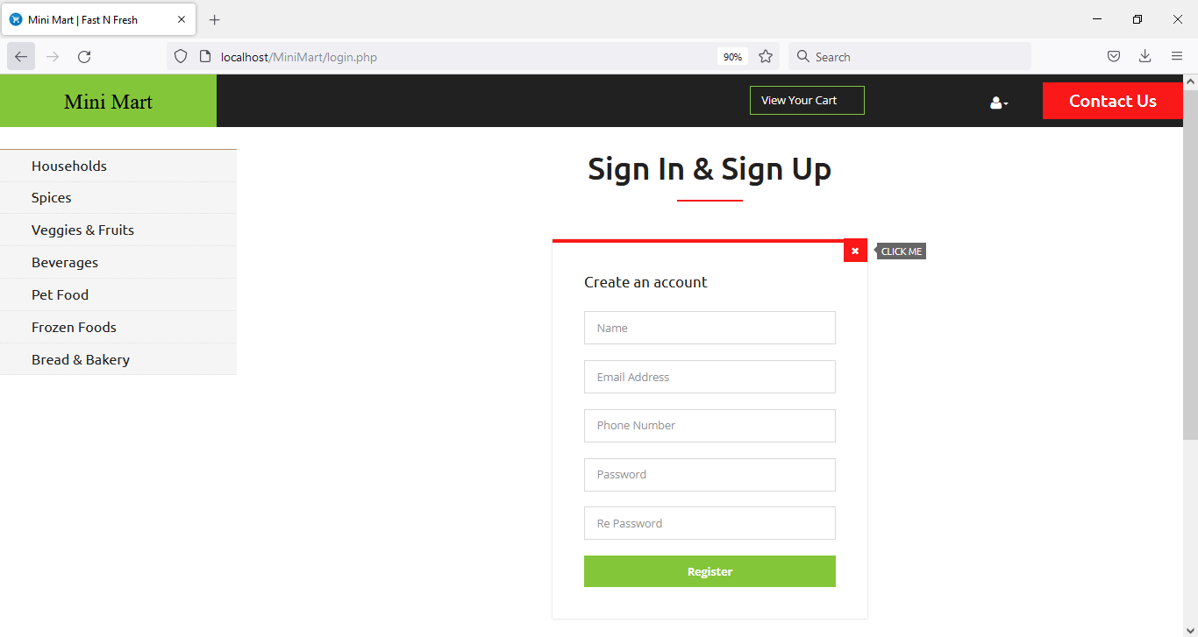
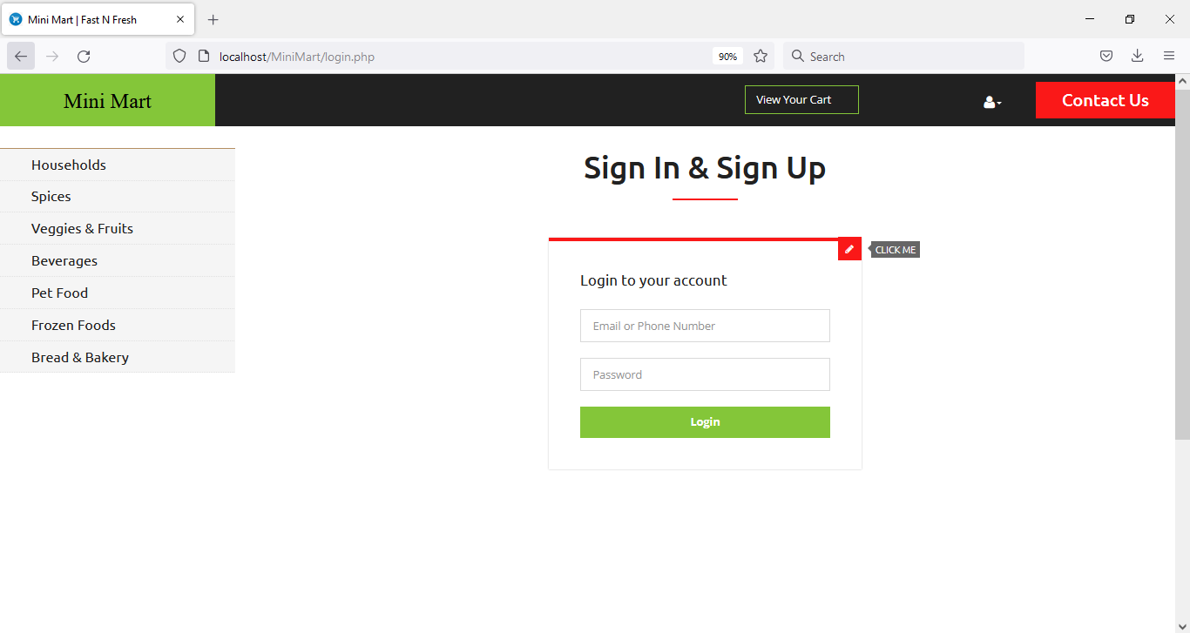

Slide 16
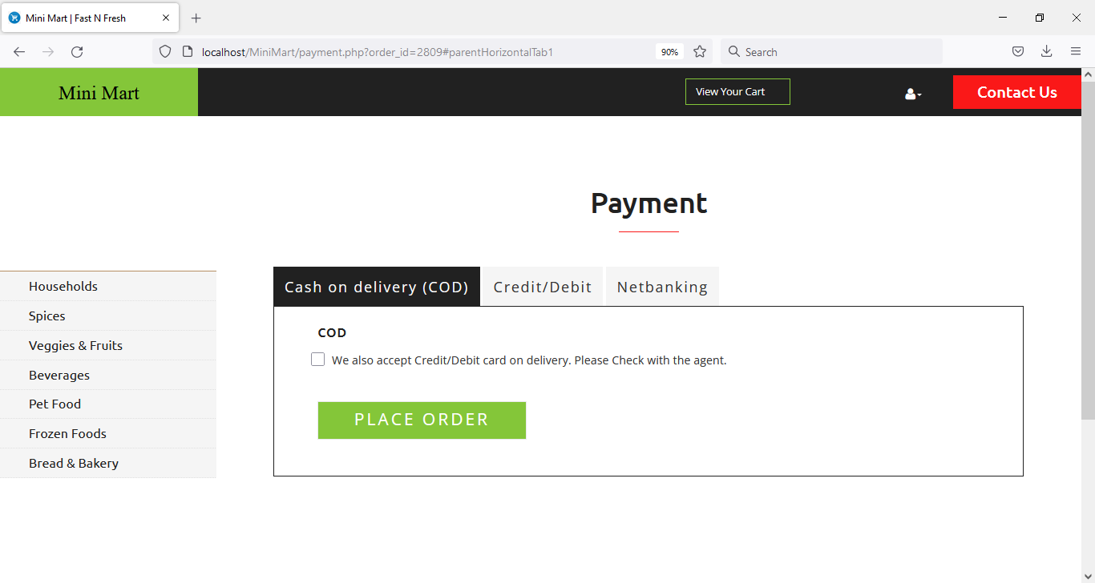
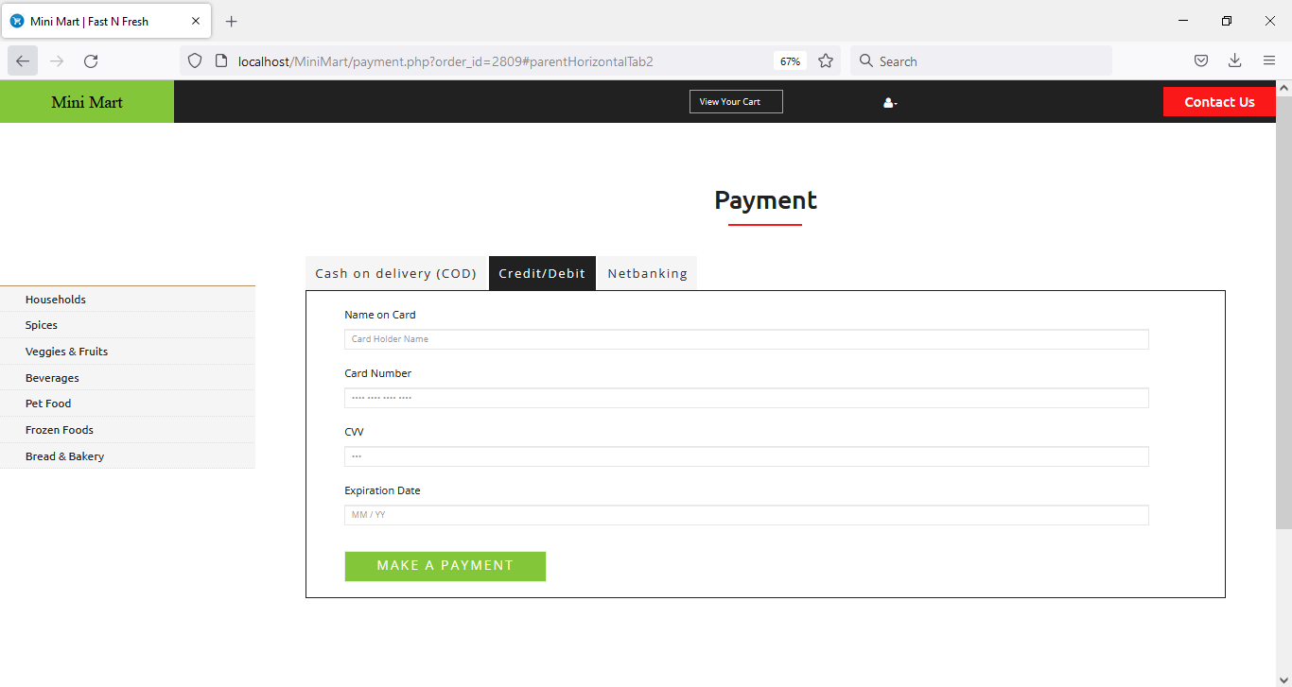
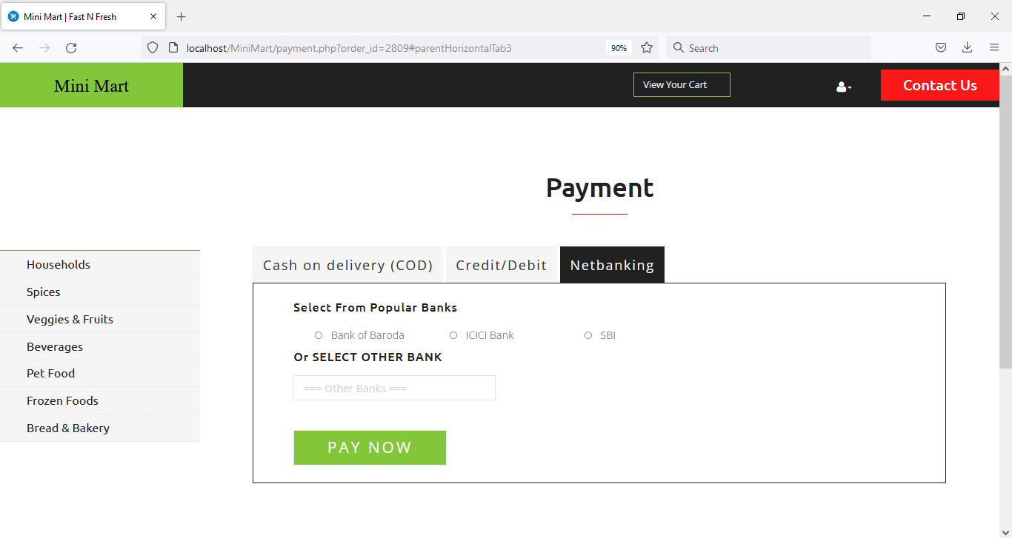

Slide 17
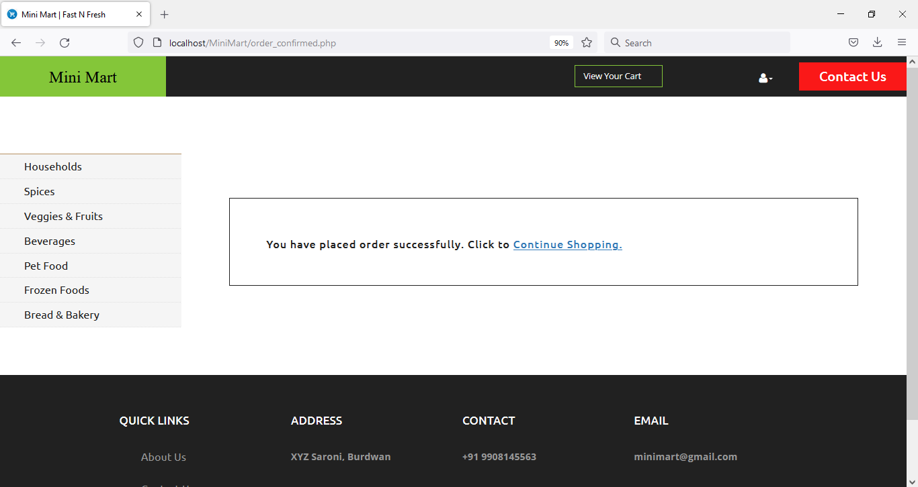

Slide 18
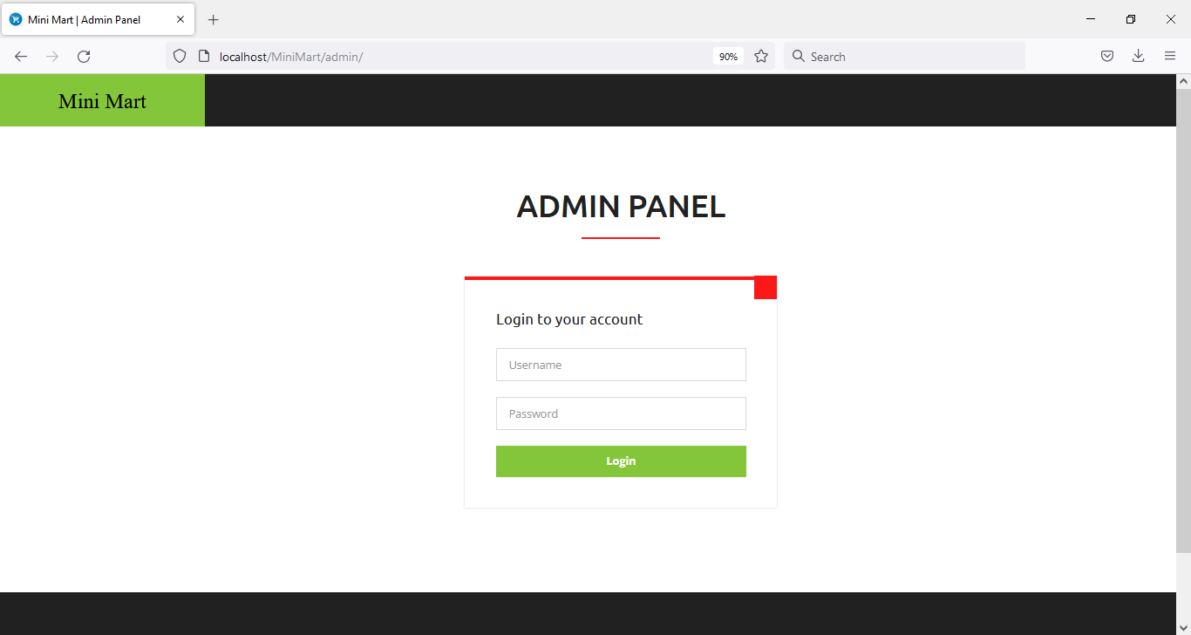
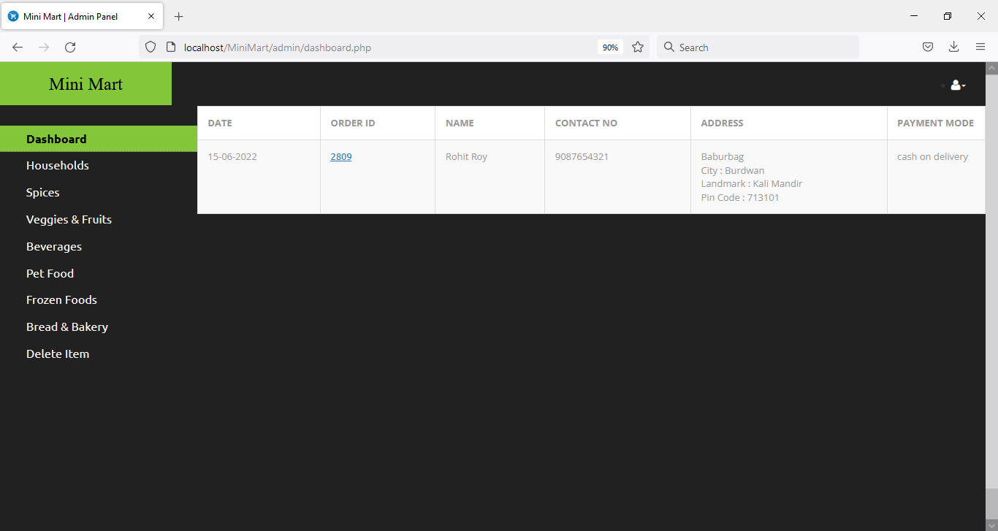

Slide 19
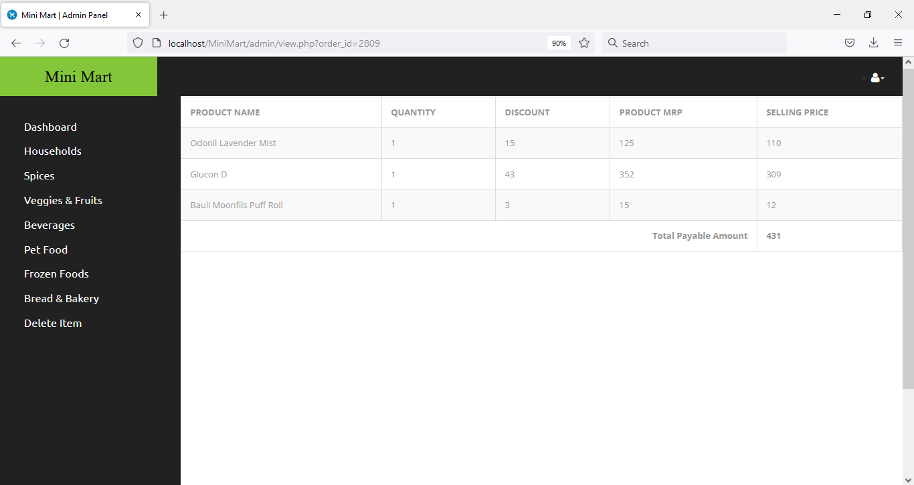
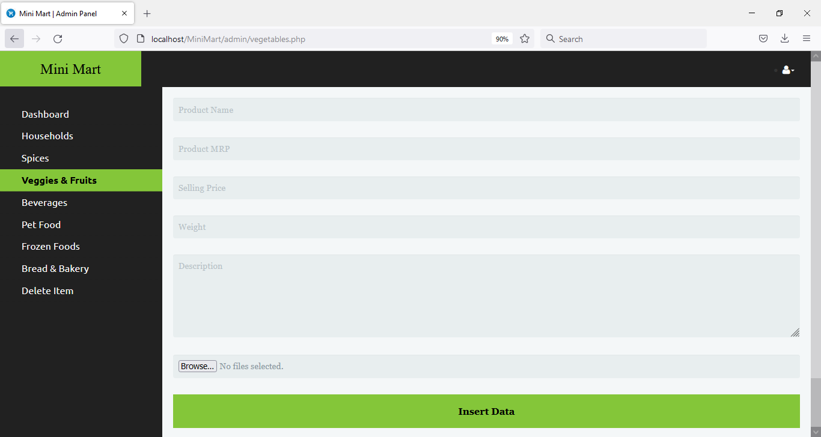

Slide 20
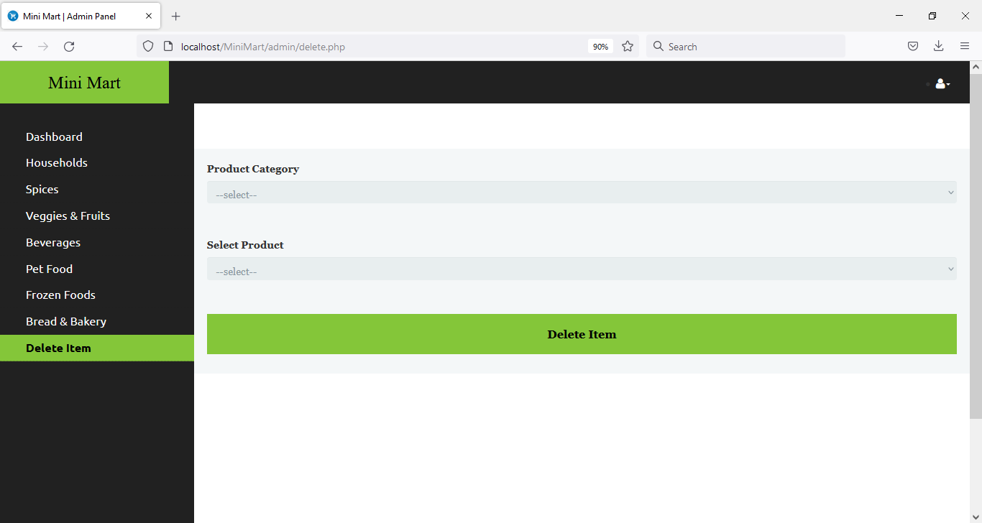


Slide 21
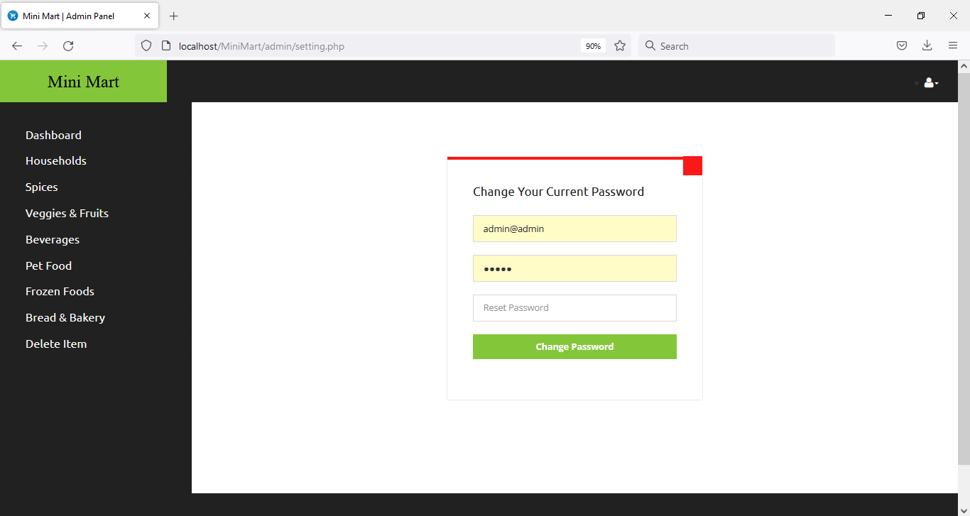

Slide 22
FUTURE SCOPE
This project has been developed with much care and free of errors and at the same time it is efficient and less time consuming. The purpose of this project is to develop a web application for purchasing items from a shop.
This project has given us great satisfaction in having designed an application which can be implemented to any nearby shops or branded shops selling various kinds of products by simple modifications

Slide 23
THANK YOU

